Slide 1
Introduction to ICO and CRO
Authors: Cooper Stansbury^{A}, J. Neil Otte^{B✫}, Jonathan Vajda^{B}, Yongqun He^{C}, Frank J. Manion^{C}, Elizabeth Umberfield^{C}, Marcelline Harris^{C}, Jihad Obeid^{D}, Mathias Brochhausen^{E}, William D. Duncan^{F}, and Cui Tao^{G}
Affiliations: University at Buffalo, Buffalo, NY^{B}; University of Michigan, Dearborn, MI^{A}; University of Michigan, Ann Arbor, MI^{C}; Medical University of South Carolina, Charleston, SC^{D}; University of Arkansas for Medical Sciences, Little Rock, AR^{E}; Roswell Park Comprehensive Cancer Center, Buffalo, NY^{F}; University of Texas Health Science Center Houston, Houston, TX ^{G}
Acknowledgements: This research is supported in part by NHGRI of the National Institute of Health under award number 5U01HG009454-02, Tao PI.

Slide 2
Background
Ontologies of Informed Consent
ICO: the Informed Consent Ontology
CRO: the Common Rule Ontology
Notes:
This is a walk.

Slide 3
Background: ICO
Ontologies of Informed Consent
Primary goal: to represent the informed consent lifecycle in the biospecimen research domain.
The Informed Consent Ontology (ICO) is an open-source OBO Foundry Ontology
ICO is designed to be a reference ontology that can be extended for specific applications.
Following a Spring workshop, there was a desire to see ICO enriched with terms from D-acts and extended for use across regulatory contexts.
Notes:
This is a walk.

Slide 4
Background: ICO
Ontologies of Informed Consent
The original version of ICO was developed through an analysis of informed consent forms from two separate IRBs at the University of Michigan
Clinical research
Behavioral research
Biobanking
Candidate terms were mapped to resources such as the NCI Thesaurus and other sources where possible.
Content from the forms was aligned with the OBO foundry ontologies
Notes:
This is a walk.

Slide 5
Background: CRO
Ontologies of Informed Consent
The Common Rule Ontology (CRO) developed by Manion et al. to represent the US Common Rule.
CRO serves as a regulatory basis for informed consent
During the coordinated evolution effort CRO was tentatively renamed:
RUBRIC (RegUlatory Basis foR Informed Consent)

Slide 6
Background: CRO
Ontologies of Informed Consent
Content was derived by a text analysis of 45 CFR 46, both pre and post 2018 versions (aka the “new Common Rule”).
Concept maps were derived and validated with various stakeholders at U Mich. These included compliance personnel, biobanking experts, and IRB members.
Concept maps underwent ontological analysis.
The results were aligned with the OBO foundry and were converted to an OWL-based ontology in Protégé.
Notes:
CRO underwent a series of evaluations by both automated methods and domain experts.

Slide 7

Coordinated Evolution of Ontologies of Informed Consent
Authors: Cooper Stansbury^{A}, J. Neil Otte^{B✫}, Jonathan Vajda^{B}, Yongqun He^{C}, Frank J. Manion^{C}, Elizabeth Umberfield^{C}, Marcelline Harris^{C}, Jihad Obeid^{D}, Mathias Brochhausen^{E}, William D. Duncan^{F}, and Cui Tao^{G}
Affiliations: University at Buffalo, Buffalo, NY^{B}; University of Michigan, Dearborn, MI^{A}; University of Michigan, Ann Arbor, MI^{C}; Medical University of South Carolina, Charleston, SC^{D}; University of Arkansas for Medical Sciences, Little Rock, AR^{E}; Roswell Park Comprehensive Cancer Center, Buffalo, NY^{F}; University of Texas Health Science Center Houston, Houston, TX ^{G}
Acknowledgements: This research is supported in part by NHGRI of the National Institute of Health under award number 5U01HG009454-02, Tao PI.

Slide 8
Ontologies of Informed Consent
Agenda
ICO Refactoring Design Philosophy
Extending ICO and RUBRIC
Future Work
Optional Appendix: Working with Data (Demo)
Notes:
Workshop oppurtunities
ICO and RUBRIC efforts are currently under development
Please give us feedback. Push our representations up against new use-cases
Help us to find entities related to informed consent processes that are not yet represented
Let’s find ways to collaborate and strengthen representations across ontologies

Slide 9
Motivation for Refactoring ICO And CRO
1
2
3
4
Simplify and Extend Existing Representations
Support Tracking of Consent Over Time and Across Regulatory Contexts
Model Deontic Roles and Align with D-acts
Align ICO, RUBRIC and DUO
Notes:
Walk?
Represent informed consent across multiple regulatory contexts
Simplify existing representations:
Support greater interoperability
Support multiple contexts of use at the application level
Further develop processes and subprocess of informed consent
Represent social phenomenon related to informed consent
Align representations among DUO, RUBRIC and ICO

Slide 10
Informed Consent Ontology Ecosystem
Ontologies of Informed Consent
Basic Formal Ontology
BFO
Existing Ontologies
The Information Artifact Ontology
The Focus of Refactoring Effort
IAO
Imported by
The Document Acts Ontology
D-Acts
DUO
ICO
RUBRIC
The Data Use Ontology
The Informed Consent Ontology
The Regulatory Basis of Informed Consent
Notes:
WHY BOTH? WHAT IS RUBRIC?

Slide 11
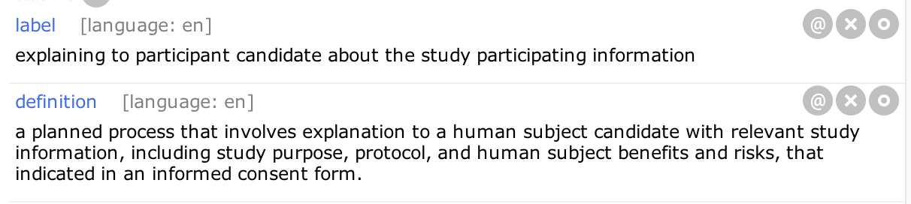
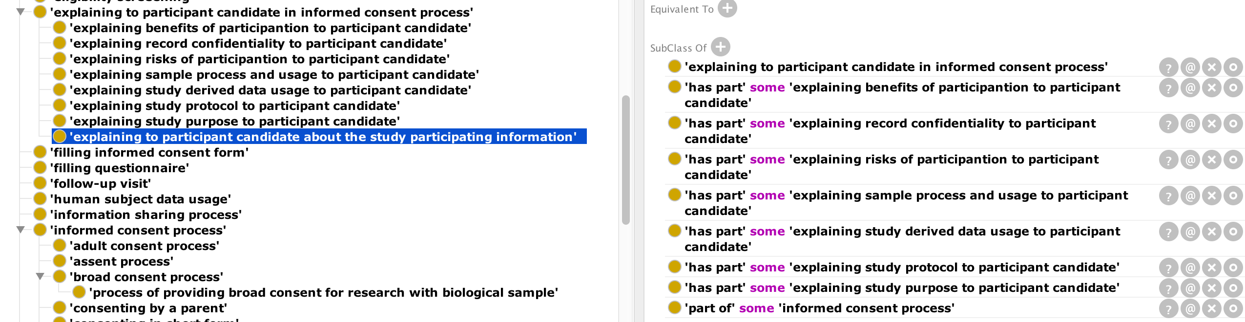
Ontologies of Informed Consent
Simplification Opportunities: Previous Version of ICO
Notes:
Issues: 1) These classes didn’t involve information content entities as participants. Hence a separate hierarchy of information content entities would duplicate the what-is-explained in these processes, but this was never created. 2) The process parts of these processes are all necessary, but whether or not they must hold will vary from context to context. For this reason, the file seemed to presuppose a definition provided by a protocol, but in generalizing ICO, we’re interested in processes across regulatory jurisdictions. This made subclass axioms of this sort inappropriate.

Slide 12
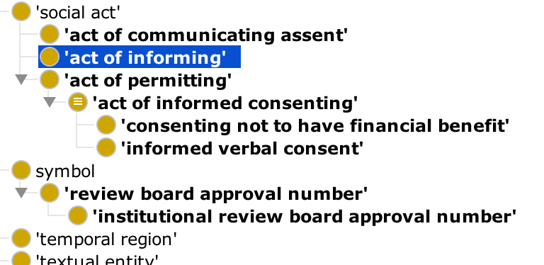
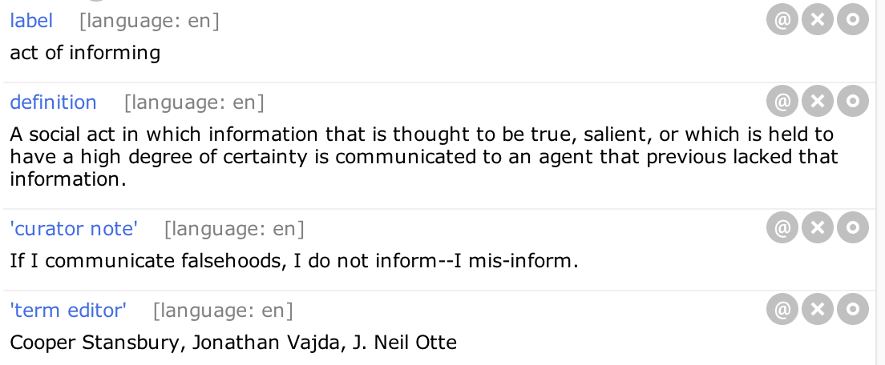
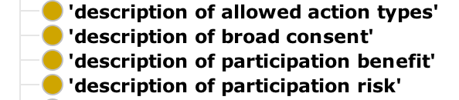
Ontologies of Informed Consent
Example Of Refactoring
…
…
Notes:
Take away: The relation between ‘Act of Informing’ and the various types of information that are explained is contingent, and will vary, depending on what rules (i.e. Directive Information Content Entities) prescribe the ‘Act of Informing’.

Slide 13
Ontologies of Informed Consent
Example Of Refactoring
…
…
act of informing
description of participation benefit
participant in
participant in
description of participation risk
prescribes
directive information entity
instance
Notes:
Take away: The relation between ‘Act of Informing’ and the various types of information that are explained is contingent, and will vary, depending on what rules (i.e. Directive Information Content Entities) prescribe the ‘Act of Informing’.

Slide 14
Ontologies of Informed Consent
Example Of Refactoring
…
description of broad consent
…
participant in
act of informing
description of participation benefit
participant in
participant in
description of participation risk
prescribes
directive information entity
instance
Notes:
Take away: The relation between ‘Act of Informing’ and the various types of information that are explained is contingent, and will vary, depending on what rules (i.e. Directive Information Content Entities) prescribe the ‘Act of Informing’.
Note: we will cover directive information and ‘prescribes’ a little later on…

Slide 15
Note: Asserted vs. Defined Classes
Ontologies of Informed Consent
Asserted Classes are those classes that lack an equivalence axiom.
In the BFO framework, asserted classes correspond to universals.
All asserted classes must avoid multiple inheritance.
Defined Classes are those classes that have an equivalence axiom.
In the BFO framework, defined classes do not correspond to universals and are included as a matter of convenience.
Defined classes are not required to avoid multiple inheritance.
Notes:
A Walk
Presentation Comment: Terms like ‘Specification of Recontact Method’ are not particular to informed consent forms. This means they should be allowed to be more general. If users then want the term ‘specification of recontact method in informed consent form’ to be a class, then they can make it a defined class in an extension of this ontology.

Slide 16
Result of Design Choices
Ontologies of Informed Consent
Use of substantially fewer subclass axioms.
Reduction of duplicate semantic content by using defined classes.
Notes:
A Walk

Slide 17
Example
Ontologies of Informed Consent
Previously:
Asserted Class: ‘specification of recontact method in informed consent form’
Revised:
Asserted Class: ‘specification of recontact method’
Asserted Class: ‘informed consent form’
Notes:
A Walk
Presentation Comment: Terms like ‘Specification of Recontact Method’ are not particular to informed consent forms. This means they should be allowed to be more general. If users then want the term ‘specification of recontact method in informed consent form’ to be a class, then they can make it a defined class in an extension of this ontology.

Slide 18
Simplified Representations
Small, general asserted classes facilitate better interoperability by reducing assumptions
Increase representational flexibility by allowing for customized defined classes at the application level
Previous Version of ICO
Active Ontology
217 classes, including parent classes from imports.
Revision of ICO
Active Ontology
184 classes, including parent classes from imports

Slide 19
Some RUBRIC Alignment Goals
Ontologies of Informed Consent
Expand representation beyond the US Common Rule
Represent ‘informed consent’ in different legal contexts and jurisdictions
Concurrent effort with ICO refactoring
Notes:
Query consent documents for biospecimens that exhibit appropriate consent criteria
Query all descriptions of risks, benefits, and vulnerable populations
Query across international bodies of legislation to discover differences in requirements concerning what needs to be explained to the patient, what needs to be disclosed, what restriction types are present within forms, etc....

Slide 20
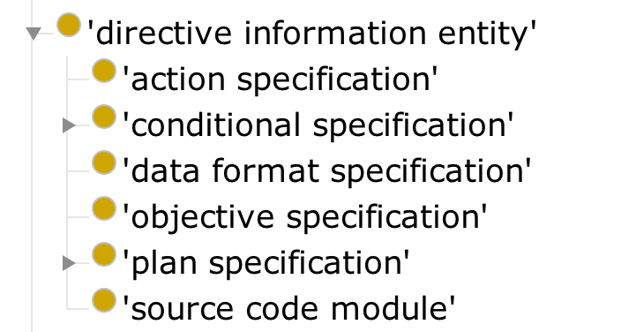
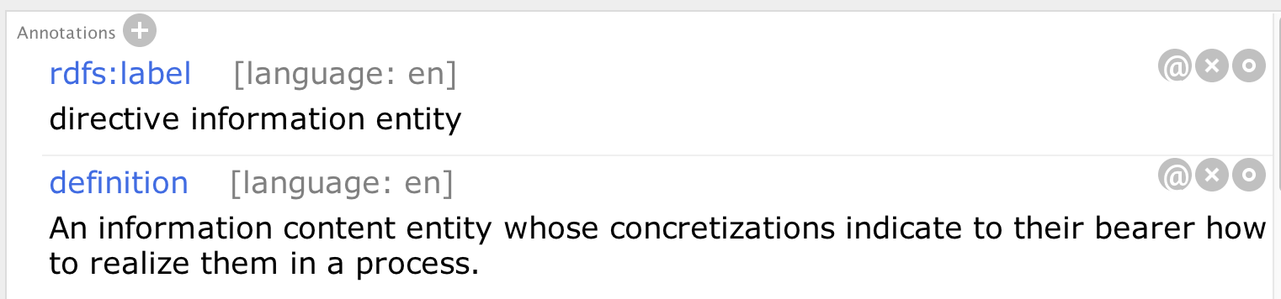
IAO: Directive Information Entity
Ontologies of Informed Consent
Existing IAO structure important to, but insufficient for, capturing components of informed consent documents
Notes:
Prescribes: “For all types T1 and T2, if T1 prescribes T2, then there is some instance of T1, t1, that serves as a rule or guide to some instance of T2, t2 (if T2 is a type of bfo:Occurrent) or that serves as a model for some instance of T2, t2 (if T2 is a type of bfo:Continuant)”¹.

Slide 21
A Simplified Example
informed consent form
has part
directive information entity
prescribes
act of informing
instance
Notes:
Prescribes: “For all types T1 and T2, if T1 prescribes T2, then there is some instance of T1, t1, that serves as a rule or guide to some instance of T2, t2 (if T2 is a type of bfo:Occurrent) or that serves as a model for some instance of T2, t2 (if T2 is a type of bfo:Continuant)”¹.

Slide 22
A Simplified Example
human subject research regulatory document
has part
directive information entity 1
prescribes
informed consent form
has part
directive information entity 2
prescribes
act of informing
instance
Notes:
Prescribes: “For all types T1 and T2, if T1 prescribes T2, then there is some instance of T1, t1, that serves as a rule or guide to some instance of T2, t2 (if T2 is a type of bfo:Occurrent) or that serves as a model for some instance of T2, t2 (if T2 is a type of bfo:Continuant)”¹.

Slide 23
Ontologies of Informed Consent
What’s missing from the Representation?
Time: When do some set of rules hold?
Space: Where do some set of rules hold?
Agent Modeling: If a researcher is fired or changes institutions, does she still have a patient’s consent?
Legal Status: When does a rule have the status of a regulation that must be followed?

Slide 24
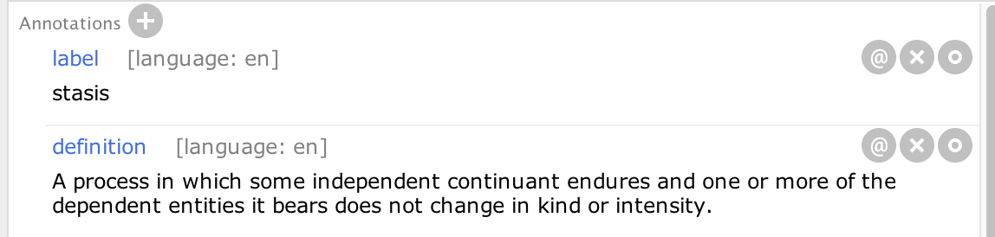
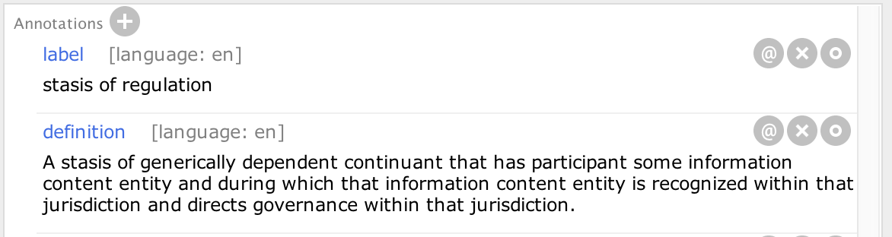
Stasis
Copyright (c) 2017, CUBRC, Inc. All rights reserved.
Notes:
Note: there is an intermediate ‘stasis of GDC’ in the actual ontology that also comes from the CCO.

Slide 25
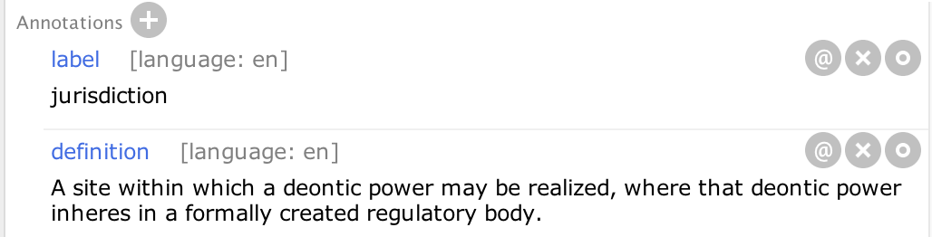
Jurisdiction
Two senses:
A geopolitical context
A power
Possible area of future work
Notes:
RUBRIC defines jurisdiction as a BFO site, identifiable through shared context of other entities, like a country or state border, or the grounds of an institution. The term ‘deontic power role’ reflects the sense of ‘power’ sometimes used to describe jurisdiction.

Slide 26
Jurisdiction

Slide 27
[Place here a sub section on Document Acts and deontic roles, deontic power roles, and permission roles (D-Acts)]

Slide 28
[
We need a slide showing what Informed Consent Process Parts we have and requesting candidate additions
We need a slide showing what Informed Consent Document Parts we have and requesting candidate additions
We need a slide on Deontic Roles stating this is ongoing.
We need a slide indicating that we’re looking to create an extension of the file for those using software that requires many additional class terms that are not needed in the ICO file, as well as a FOL specification of D-Acts and ICO.
]

Slide 29
Further Alignment
Ontologies of Informed Consent
[
We need a slide showing what Informed Consent Process Parts we have and requesting candidate additions
We need a slide showing what Informed Consent Document Parts we have and requesting candidate additions
We need a slide on Deontic Roles stating this is ongoing.
We need a slide indicating that we’re looking to create an extension of the file for those using software that requires many additional class terms that are not needed in the ICO file, as well as a FOL specification of D-Acts and ICO.

Slide 30
Proof of Concept Use-Cases
Ontologies of Informed Consent
Informed Consent Document Templates
NLP
Informed Consent Triplestore
Informed Consent Ontology
Research Queries
Institution
Biobank Data
RDF Ingestion Pipelines

Slide 31
Proof of Concept Use-Cases
Ontologies of Informed Consent
Mapping Script
Institution
Biobank Data
Informed Consent Triplestore
Informed Consent Ontology
i2b2 instance
Research Queries
RDF Ingestion Pipeline

Slide 32
Insert thanks to all team members
Insert pictures, names, affiliations, and emails of Scrub Team Members
Insert thanks to funding organization

Slide 33
RDF: A Small Example
Ontologies of Informed Consent
RDF: Rich Descriptive Framework
“Sally loves logic.”
Subject
predicate
Object

Slide 34
Ontologies of Informed Consent
RDF: Rich Descriptive Framework
“Sally loves logic.”
Subject
predicate
Object
1. subj: Sally pred: loves obj:logic
2. subj: Sally pred: enjoys obj:philosophy
3. subj: Sally pred: studies obj:medicine
4. subj: Fred pred: brother_of obj:Sally
5. subj: Sally pred: dogs obj:cats
6. subj: Sally pred: democrat obj:democrat
7. subj: Sally pred: Sally obj:Sally
8. […]
RDF Triple Store

Slide 35
Ontologies of Informed Consent
RDF: Rich Descriptive Framework
“Sally loves logic.”
Subject
predicate
Object
OWL: Web Ontology Language
1. subj: Sally pred: loves obj:logic
2. subj: Sally pred: enjoys obj:philosophy
3. subj: Sally pred: studies obj:medicine
4. subj: Fred pred: brother_of obj:Sally
5. subj: Sally pred: dogs obj:cats
6. subj: Sally pred: democrat obj:democrat
7. subj: Sally pred: Sally obj:Sally
8. […]
RDF Triple Store

Slide 36
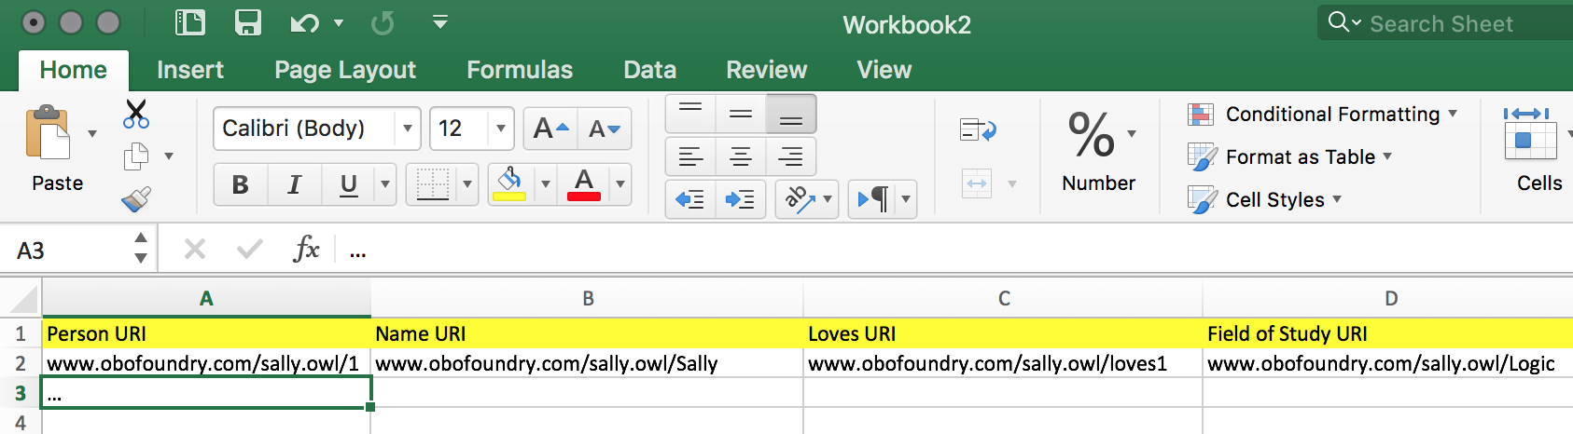
Ontologies of Informed Consent
Tabular Data to RDF triples
RDF Triplestore
1. subj: Sally pred: loves obj:logic
2. subj: Sally pred: enjoys obj:philosophy
3. subj: Sally pred: studies obj:medicine
4. subj: Fred pred: brother_of obj:Sally
5. […]

Slide 37
Ontologies of Informed Consent
A Basic Workflow
Analyze your domain.
Identify universals and relations.
Define and add axioms for your terms.
Start drawing graphs.
Create your ontology.
Notes:
HTTP and SOAP are both different protocols for SPARQL.

Slide 38
Ontologies of Informed Consent
A Basic Workflow
Analyze your domain.
Identify universals and relations.
Define and add axioms for your terms.
Start drawing graphs.
Create your ontology.
Use Protégé to implement your ontology in a language.
Import the ontologies you will re-use.
Create classes and object properties.
Leave your reasoner running as you work.
Save your file in a language.
Post file to a public repository like Github.
Notes:
HTTP and SOAP are both different protocols for SPARQL.

Slide 39
Ontologies of Informed Consent
A Basic Workflow
Analyze your domain.
Identify universals and relations.
Define and add axioms for your terms.
Start drawing graphs.
Create your ontology.
Use Protégé to implement your ontology in a language.
Import the ontologies you will re-use.
Create classes and object properties.
Leave your reasoner running as you work.
Save your file in a language.
Post file to a public repository like Github.
Create a knowledgebase by aligning data to your ontology.
Pick an alignment tool.
Export your mapping and your RDF.
Create an RDF Triplestore by hosting your RDF on a server.
Query your RDF data with a SPARQL endpoint.
Notes:
HTTP and SOAP are both different protocols for SPARQL.

Slide 40
BFO: generically dependent continuant
CCO: descriptive information content entity
IAO: directive information entity
IAO: document
D-acts: document act input document
ICO: description of risk
ICO: informed consent form
RUBRIC: description of medical procedure
RUBRIC: permission directive
date specification
has part
Informed consent form
description of liability
description of medical procedure
has part
has part
“Instance of” relation
“Is a” relation
has part
has part
description of risk
has part
Universal
description of voluntary participation
permission directive
describes
Particular
participates in
prescribes
Defined Class
informed consent process
has process part
act of consent
has output
permission role
bearer of
research institution 1

Slide 41
BFO: process
is a
is a
is a
BFO: material entity
BFO: role
is a
is a
ICO: act of consent
OBI: informed consent process
is a
is a
ICO: act of authorization
OBI: investigation
is a
BFO: generically dependent continuant
OBI: principal investigator role
is a
is a
OBIB: specimen
NCIT: homo sapiens
is a
ICO: deontic power role
ICO: permission role
OBI: organization
is a
directive information content entity 2
OBI: patient role
act of authorization 1
has output
deontic power role 2
inheres in
research institution 2
IAO: directive information content entity
prescribes
realized in
realized in
act of authorization 2
deontic power role 1
bearer of
research institution 1
has output
bearer of
permission role 1
directive information content entity 1
prescribes
permission role 2
bearer of
Gregory House, MD
has output
prescribes
has output
prescribes
Universal
permits
agent in
act of consent
informed consent process
investigator role
bearer of
has process part
realized in
Particular
research study
realized in
principal investigator role
realized in
bearer of
has participant
Cooper Stanbury
bearer of
patient role
Doogie Hauser, MD
biospecimen

Slide 42
BFO: process
is a
is a
is a
BFO: material entity
BFO: role
is a
is a
ICO: act of consent
OBI: informed consent process
is a
is a
ICO: act of authorization
OBI: investigation
is a
BFO: generically dependent continuant
OBI: principal investigator role
is a
is a
OBIB: specimen
NCIT: homo sapiens
is a
ICO: deontic power role
ICO: permission role
OBI: organization
is a
directive information content entity 2
OBI: patient role
act of authorization 1
deontic power role 2
research institution 2
IAO: directive information content entity
act of authorization 2
deontic power role 1
research institution 1
permission role 1
directive information content entity 1
permission role 2
Gregory House, MD
instance of
Universal
act of consent
informed consent process
investigator role
Particular
research study
principal investigator role
Cooper Stanbury
patient role
Doogie Hauser, MD
biospecimen

Slide 43
BFO: generically dependent continuant
IAO: document
CCO: descriptive information content entity
IAO: directive information entity
D-acts: document act input document
RUBRIC: answer directive
RUBRIC: conditional permission directive
RUBRIC: restriction directive
ICO: informed consent form
ICO: description of benefit
RUBRIC: description of medical procedure
RUBRIC: permission directive
ICO: description of risk
date specification
has part some
Informed consent form
has part some
description of medical procedure
has part some
“Instance of” relation
has part some
has part some
description of liability
“Is a” relation
has part some
permission directive
Universal
description of risk
description of voluntary participation
participates in
specifies
Particular
prescribes
informed consent process
has process part
act of consent
has output
permission role
research institution 1
bearer of

Slide 44
Ontologies of Informed Consent
description of medical procedure
Universal
date specification
description of liability
Particular
description of voluntary participation
has part some
has part some
has part some
specifies
has part some
Informed consent form
has part some
permission directive
participates in
prescribes
informed consent process
has process part
act of consent
has output
permission role
research institution 1
bearer of

